Slide 1


Estimating Evolutionary Stage on TRAPPIST 1-e Using Cumulative Carbon Fixed
Zephyr Kennan¹,Christopher E. Doughty¹, Cameron Hrabak¹, Ben Wiebe¹, Denis Sergeev², Nancy Y. Kiang³, Michael Gowanlock¹
¹School of Informatics, Computing, and Cyber Systems, Northern Arizona University, Flagstaff, AZ, USA, ² University of Exeter, Exeter, UK, ³ NASA Goddard Institute for Space Studies, New York, NY, USA

Slide 2
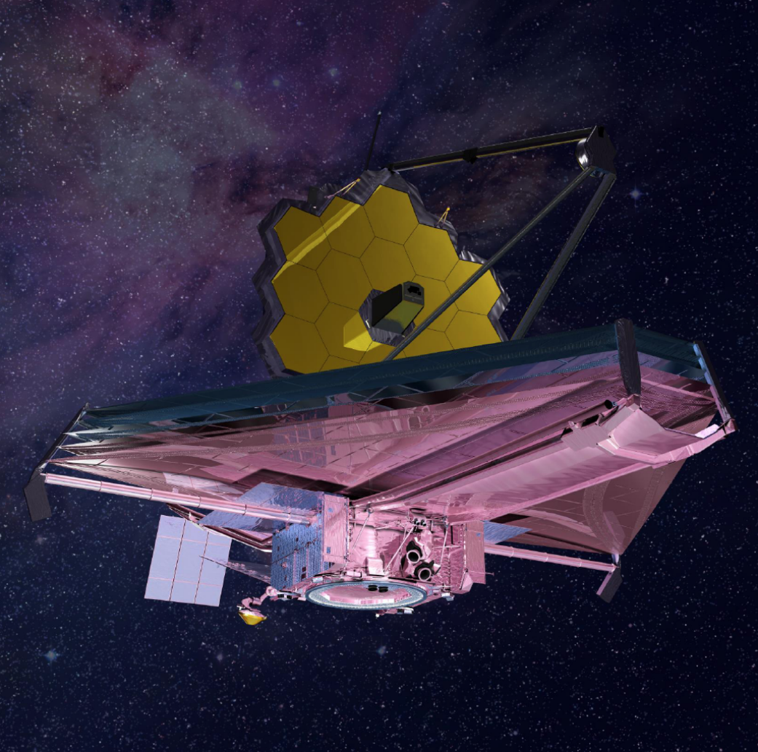
With the addition of the James Webb Space Telescope launching in 2022, we have now confirmed over 6000 exoplanets!
With such a massive amount of potential, the search for other life apart from our own has gradually coming to the forefront of astronomical research.
However, the time and effort required to look at even a single planet through space telescopes is large, and in the future methods of determining small, microbial life will probably be different than the methods of detection for larger, multicellular life
NASA
To help constrain these methods, we propose a simple hypothesis for quantizing the evolutionary stage of a planet:
The biological evolution rate is a linear function of cumulative carbon fixed on a planet.

Slide 3
How do we do this???
Now you may ask:

Slide 4
Cumulative Carbon Fixed (NPP)
The Cumulative Carbon Fixed, or Net Primary Production, is an ecological term referencing the available carbon, or energy, accumulated as biomass lives and dies. It is often used as an indicator of the heath or diversity of an ecosystem.
Greater NPP Shows that more lives have been lived
Each life has a small chance for genetic mutation, or “evolution”
Areas hypothesized to have more NPP, possibly more evolved life

Slide 5
Methods
We used simulated climatology data for T1e from the THAI experiment (Fauchez et al., 2021, 2020) as well as GCM simulated modern Earth climatology to estimate surface productivity for different atmosphere and surface composition scenarios
To model T1-e, we used the Met Office Unified Model (UM) model (Mayne et al., 2014) simulations, originally run at a low resolution of 144 x 90 pixels, and later with a higher resolution model to include simulated cloud coverage at 2560 x 1920 pixels (Sergeev et al. 2025).
These data sets were plugged into the Miami Model to estimate NPP in units of grams of dry matter m⁻² yr⁻¹ as limited by temperature and precipitation on land and temperature and nutrients in the ocean. We have added a simple function (eq 3) for nutrient limitation in the ocean, which was not in the original Miami model.
where T is temperature (°C), P is precipitation (mm/yr), N is nitrate (μmol l⁻¹), NPP_{T} is the NPP response to temperature, NPP_{P} is the response to precipitation and NPP_{N} is the response to nutrients
Equation 1a = NPP_{T} = 3000 *(1 + exp(1.315 - .119 *T))^{^-1}
Equation 1b = NPP_{T} = 3000 *(1 + exp(1.315 - .119 * (T-2*(T-threshold)))^{^-1}
Equation 2 = NPP_{P} = 3000 *(1 – exp(-0.000664 * P))
Equation 3 = NPP_{N} = 500 *(1 – exp(-0.2 * N)) We have added a simple function (eq 3) for nutrient limitation in the ocean, which was not in the original Miami model. Ocean NPP starts with a maximum of 500 g m⁻² yr⁻¹ in nutrient rich waters to < 10 g m⁻² yr⁻¹ in low nutrient waters (Boyd et al., 2014).
Equation 4a = NPP_{final_land} = min(NPP_{T}, NPP_{P})_{land}
Equation 4b = NPP_{final_ocean} = min(NPP_{T}, NPP_{N})_{oceans}

Slide 6
But wait! There’s more!
The Miami model does not incorporate light limitation on NPP; however, light is critical for photosynthesis. To incorporate radiation levels into our NPP estimates, we used maps of downwelling stellar flux at the surface in W m⁻² (F_{SW}^{down}) and equations 5 for NPP _{400-700 nm} and 6 for NPP _{400-1100 nm}.
Equation 5a – NPPland _{400-700 nm} = NPP_{final_land}(i,j) *(IPAR(i,j) /158)* (1.5/11) *((S_{p} *1361)/1135)
Equation 5b – NPPocean _{400-700 nm} = NPP_{final_ocean}(i,j) *(IPAR(i,j) /158)*( 1.4*.95+1.1*0.05)/11) *((S_{p} *1361)/1135)
Equation 6a – NPPland _{400-1100 nm} = NPP_{final_land}(i,j) *(IPAR(i,j) /158)* (16.9/11) *((S_{p} *1361)/1135)
Equation 6b – NPPocean _{400-1100 nm} = NPP_{final_ocean}(i,j) *(IPAR(i,j) /158)*( 9.9*.95+1.5*0.05)/11) *((S_{p} *1361)/1135)

Slide 7
So is TRAPPIST 1-e habitable and full of life??
No :(

Slide 8
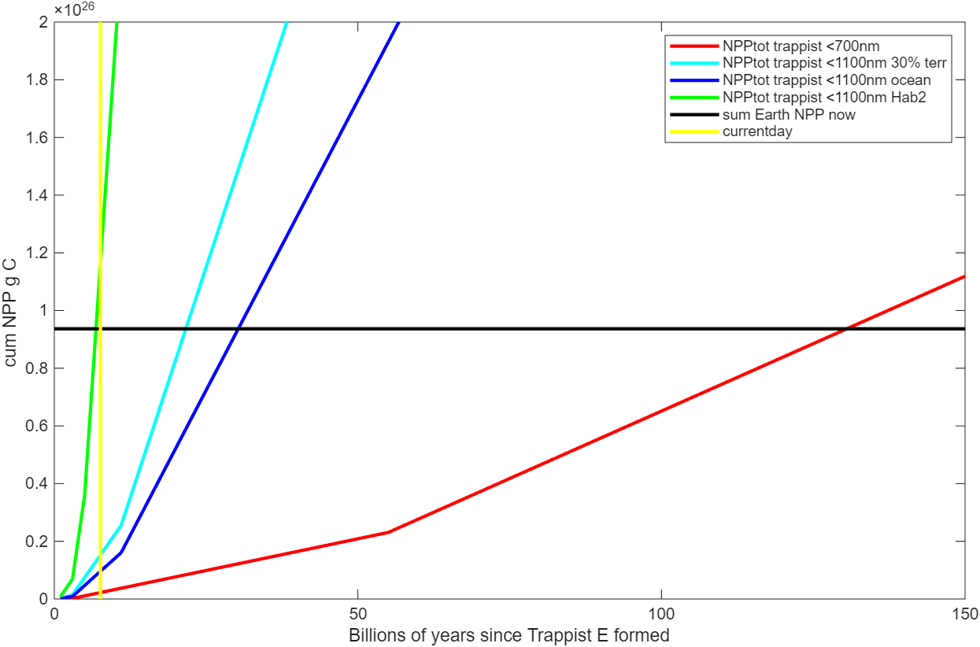
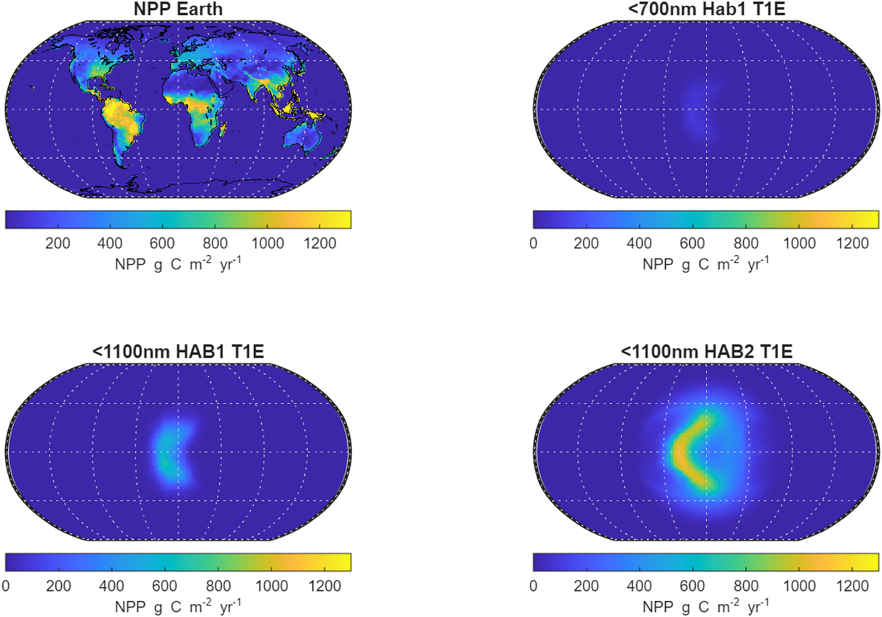
Initial Modeling from the THAI project:
We assume life on T1e started quickly like on Earth. The vertical yellow line shows 7.8 billion years which is the current estimate of the age of T1e. The horizontal black line is our estimate of total carbon fixed thus far by Earth.
Estimate of NPP on Earth (a) and Trappist 1e HAB1 <700nm (b), Trappist 1e HAB1 <11000nm (c), and Trappist 1e HAB2 <700nm (d) NPP in g m⁻² yr⁻¹ using the Miami model. On Trappist 1e we randomly assign 30% as continental area.

Slide 9
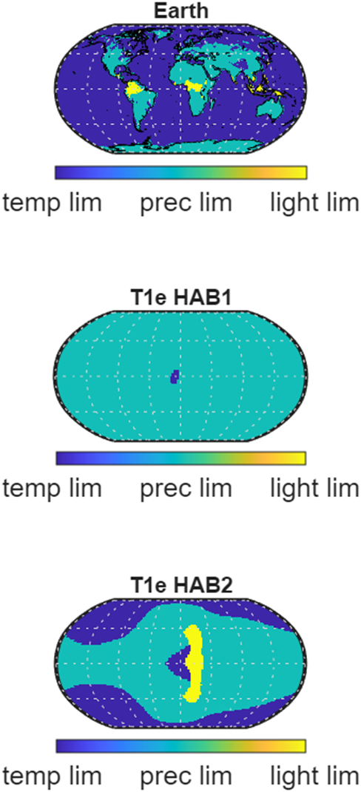
The limitations:
NPP limitations according to equation 4 for continental areas on Earth (top), T1e Hab1 (middle), and T1e Hab2 (bottom) showing whether an addition of light temperature or precipitation would lead to more NPP. This calculation is assuming a terrestrial surface for each pixel.

Slide 10
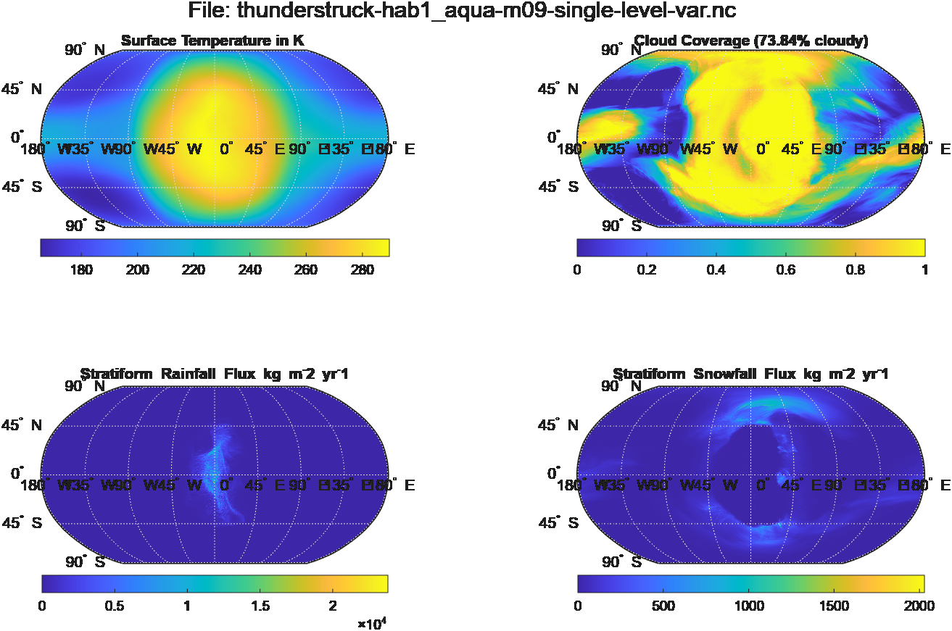
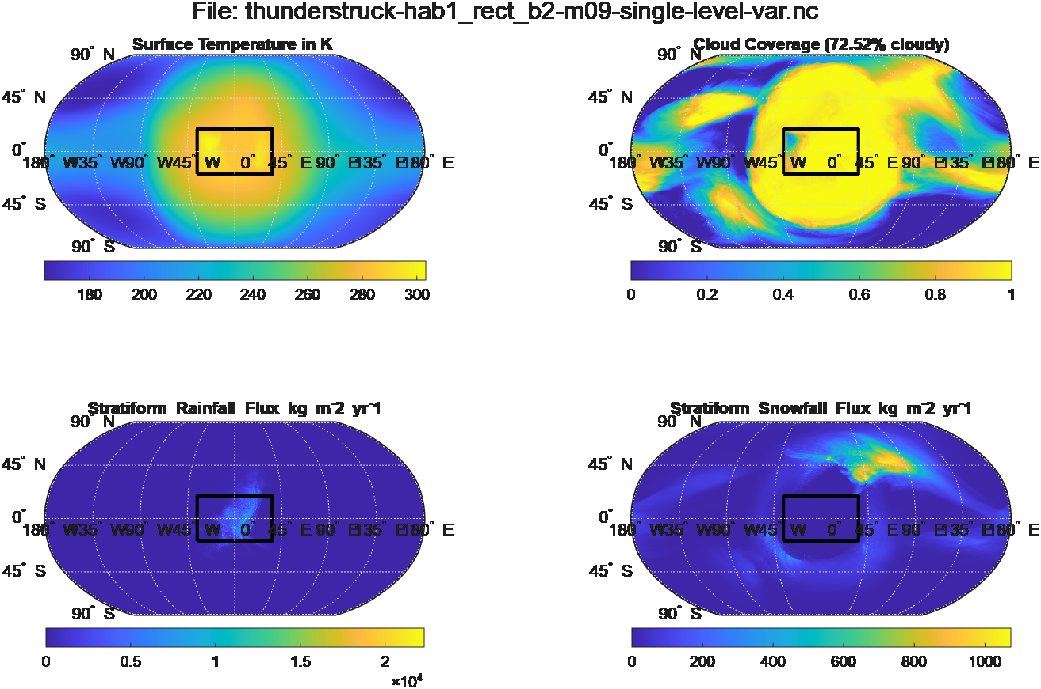
Lets try again!
United Met Model, Aqua Planet
United Met Model, Continent
New data from the United Met Model, previously being used to simulate lightning activity for a potential T1e. These data sets are done with 1 bar of pressure, mostly N2 with 400ppm CO2. The hope is the added simulations of cloud coverage will provide a greater glimpse into how NPP is distributed, and how a continental mass could affect it.

Slide 11
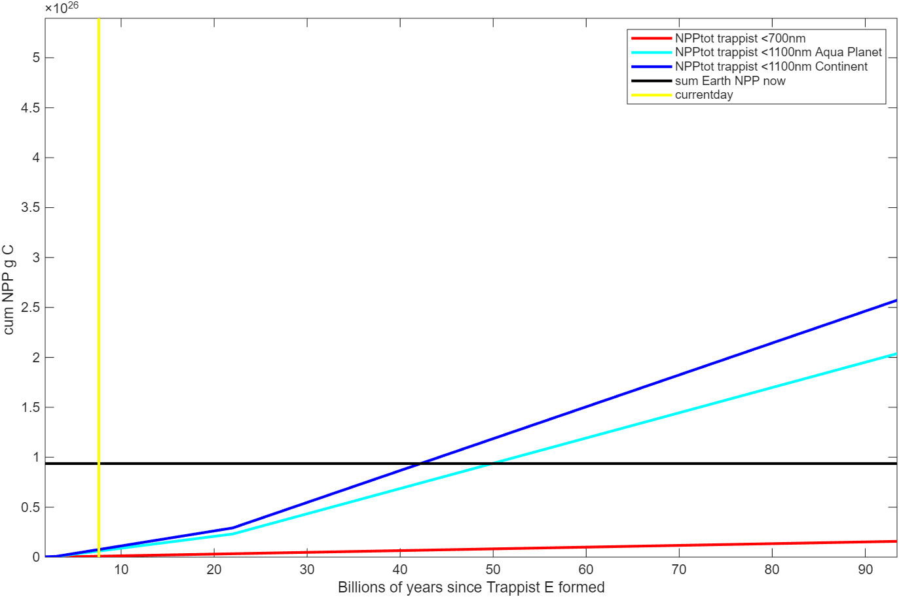
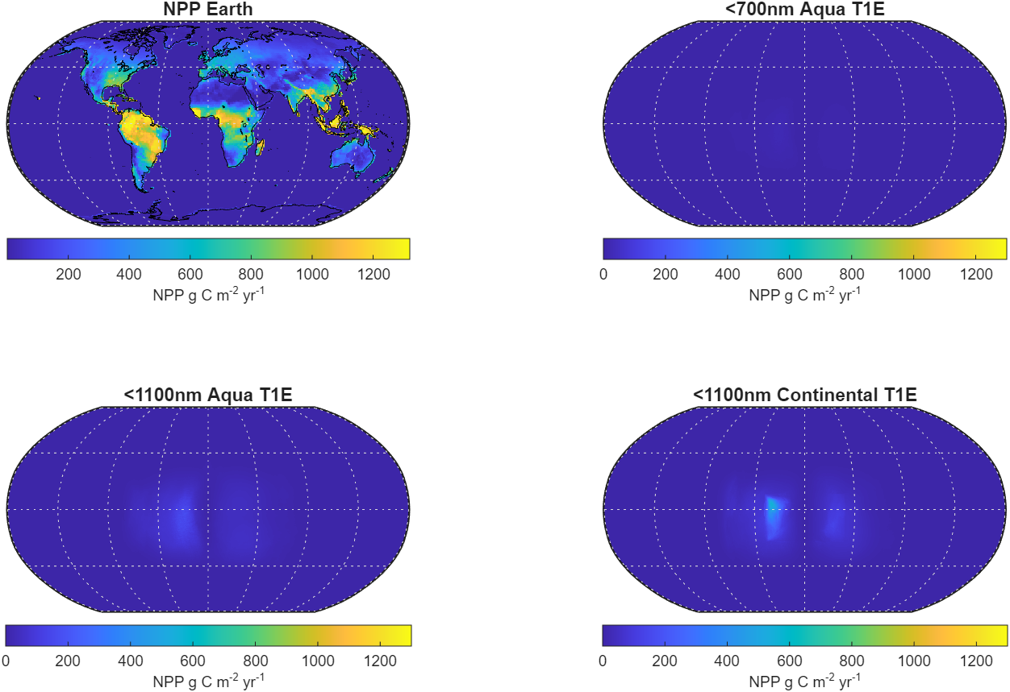
Lets try again!
With the updated models allowing for a more in-depth idea of how cloud coverage may affect the NPP, it was found that it actually severely lowered the probability of finding more advanced, multicellular life
Estimate of NPP on Earth (a) and Trappist 1e as an aqua planet using only <700nm (b), Trappist 1e as an aqua planet <1100nm (c), and Trappist 1e including continental area <1100nm (d) NPP in g m⁻² yr⁻¹ using the Miami model.
Updated cumulative NPP plot, where the black line is Earth’s current production, and yellow is present day.

Slide 12
So what now?
Our largest source of uncertainty is the planet’s atmospheric composition, or indeed even whether an atmosphere exists on these planets at all. Recent findings from the JWST on the spectra of TRAPPIST-1e rule out a thick, hazy atmosphere made primarily of H₂ (Espinoza et al., 2025). Data modeling on secondary atmospheres weakly disfavors a thick atmosphere such as that on Venus, or an airless world like Mars (Glidden et al., 2025). These models weakly favor a CH₄ rich atmosphere, with a quiet background gas such as N₂ which match well with the simulated atmospheres here.
Unfortunately, through some modeling using the Photochem atmospheric model (Wogan et al. 2025), we determined that the inclusion of methane into the atmosphere these were simulated with, which does fall into the allowed constraints from Glidden et al., does not substantially affect surface temperature or haze production, and does not make the probability of greater results possible.

Slide 13
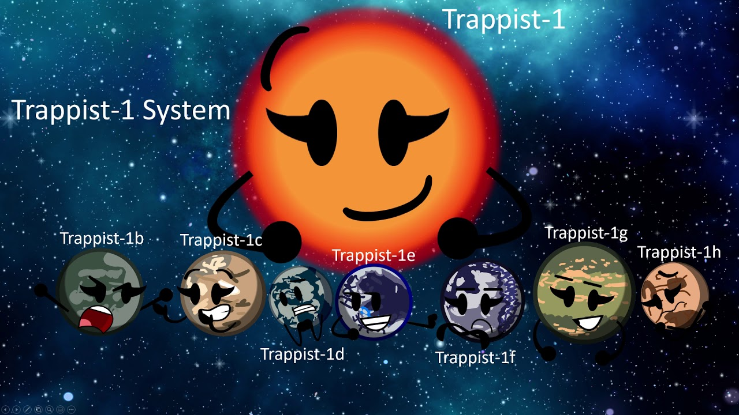
In the future:
Further modeling is up-and-coming, with the addition of more data concerning where continents are placed, and their size, and how that can also affect the cloud formation and surface temperatures of the planet. Additionally, with the use of the soon Habitable Worlds Observatory, we hope to gain more insight into the probability of an ocean existing on T1e, and how much of the surface it may cover.
Until that time, we also plan to look further into precipitation scattering on these T1e simulations, to better understand how it may affect the continental land mass, vs the ocean coverage.
https://universemagazine.com/en/trappist-1-planets-capable-of-sustaining-life/

